Slide 1

: Field of view (FOV)
: mmWave/Thz Beam
: LoS signal blockage
small BS
Obstacle
Obstacle

Slide 2
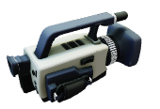

Slide 3

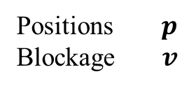

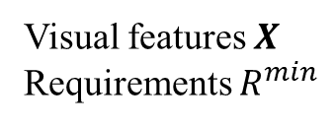
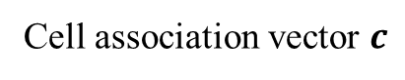
1) Input data acquisition
(Image acquisition & feature extraction)
3) UE detection
(object detection stage)
2) Input data transmission
Voxelizer
Visual features $X$
Requirements $R^{min}$
Positions $p$
Blockage $v$
5) Control signaling
Cell association vector generation
CU in macro BS
Cell association vector $c$
UDN environment
4) Cell association decision
(CA stage)

Slide 4
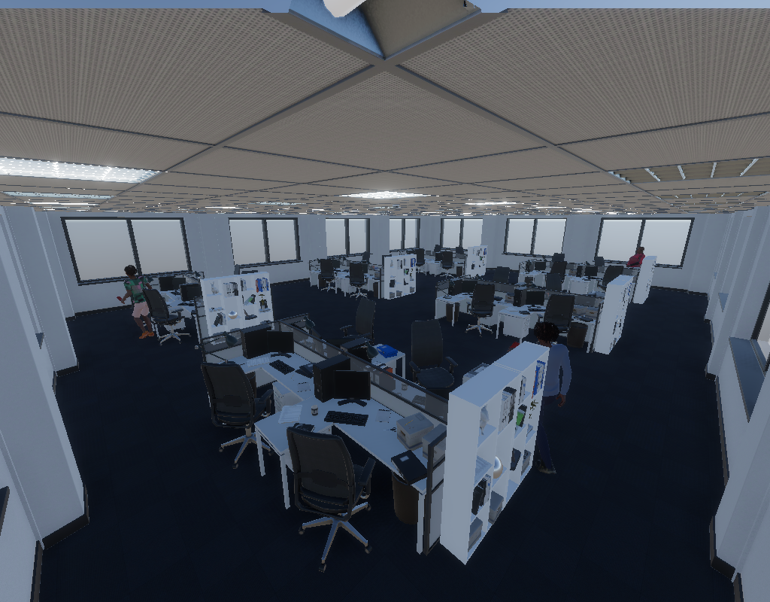
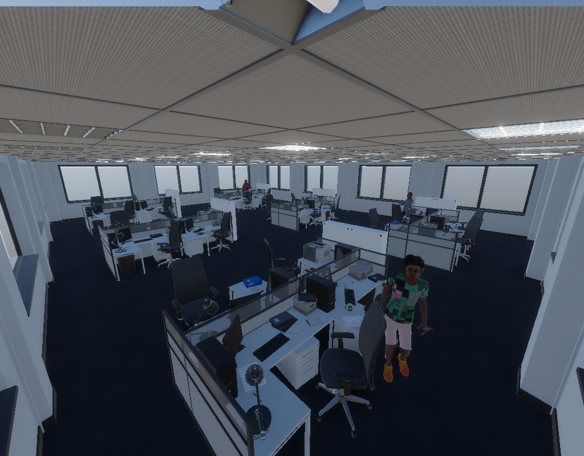
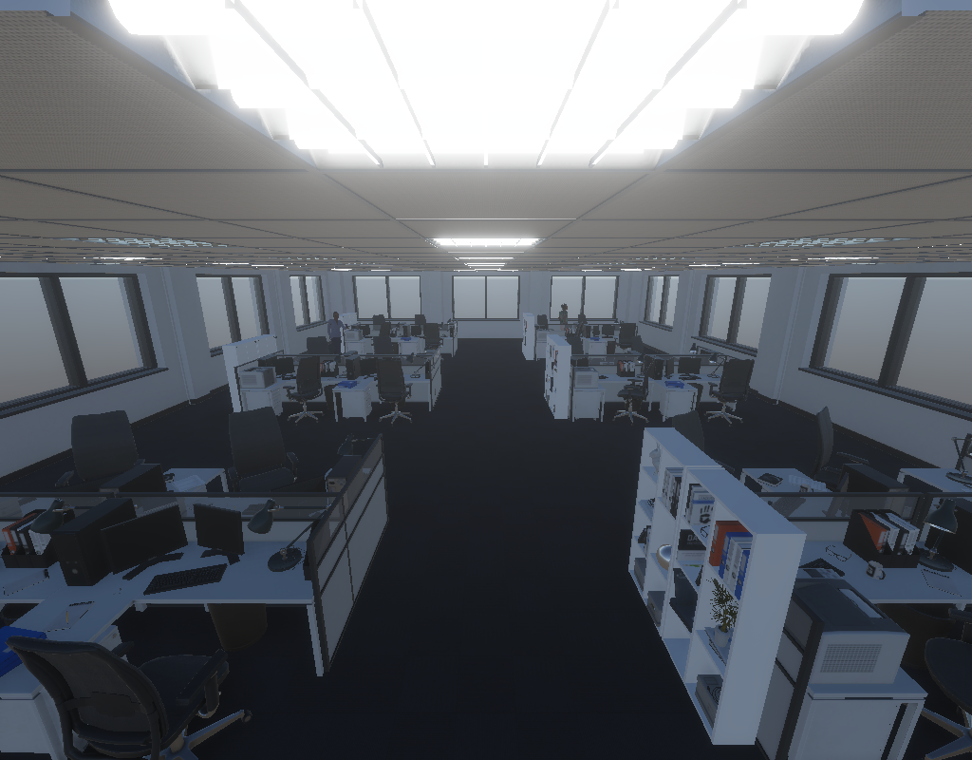
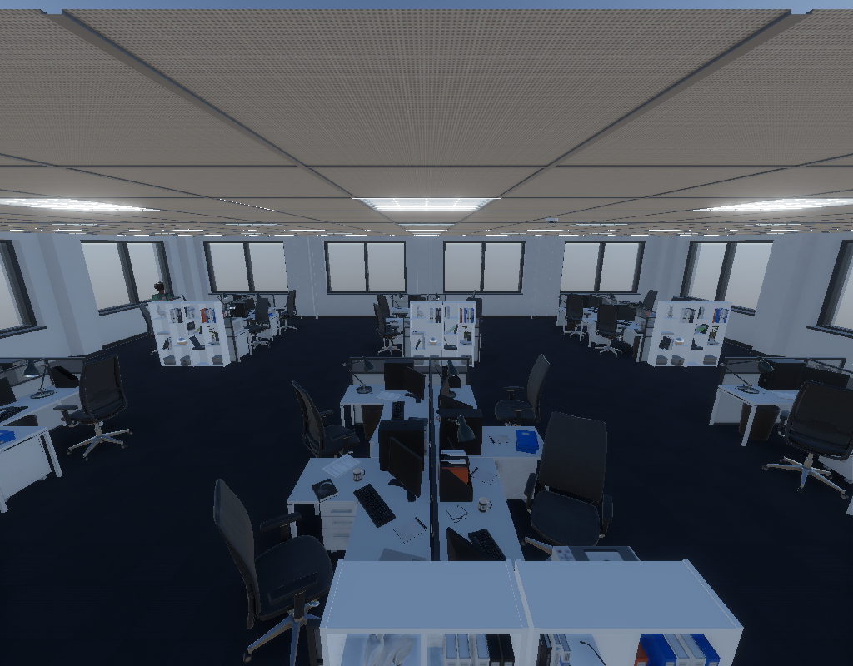
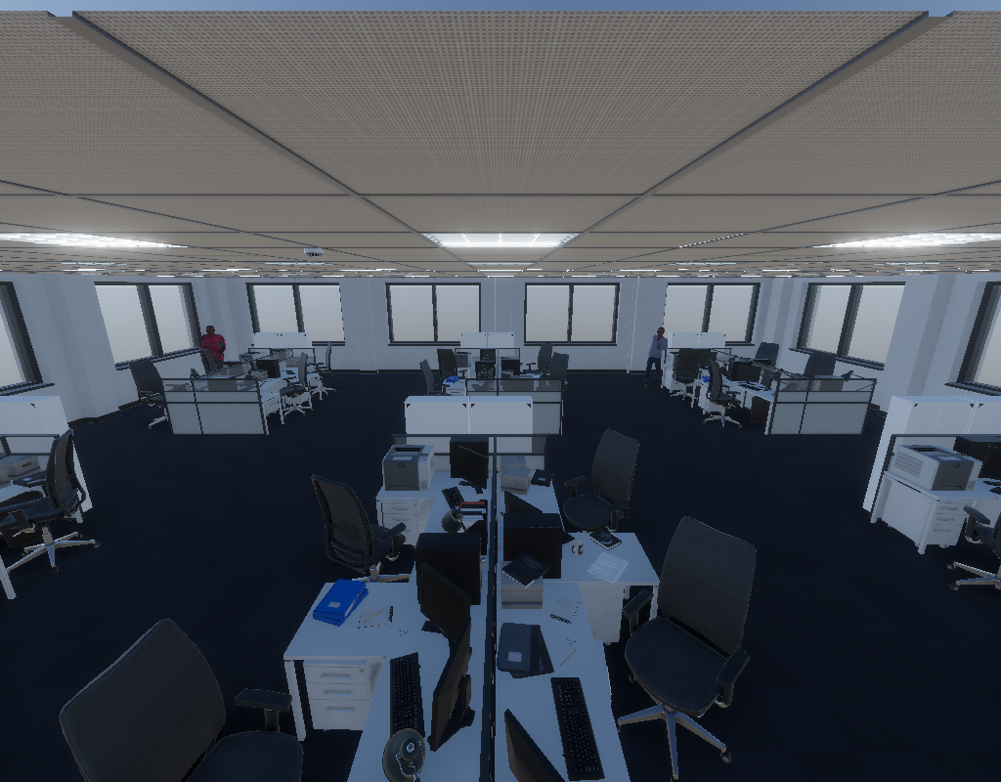
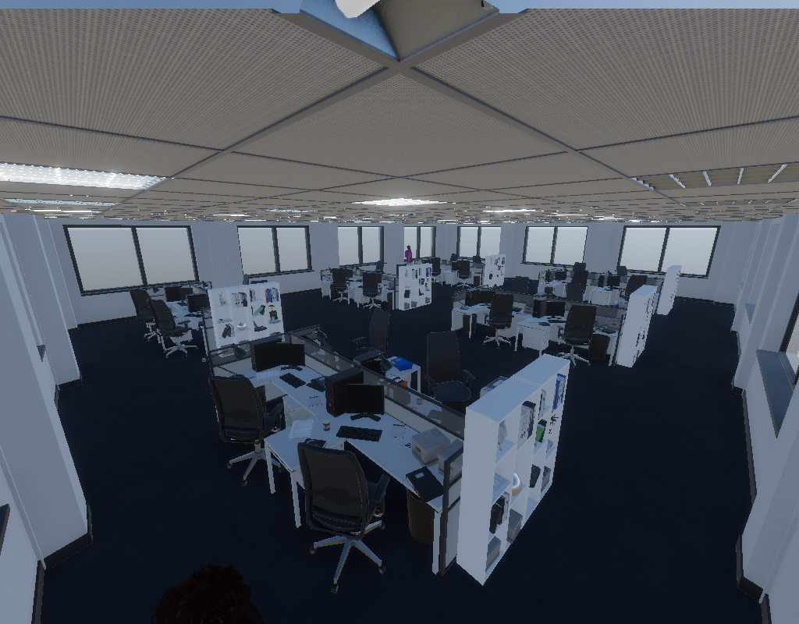
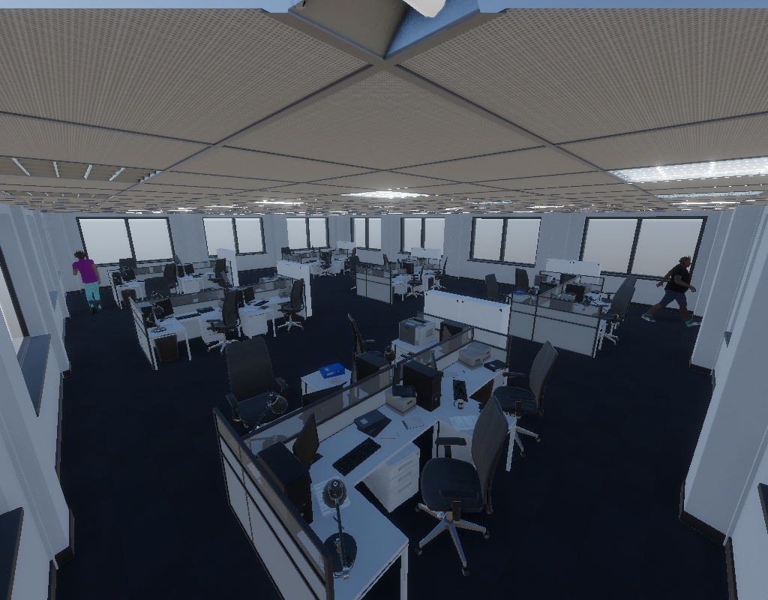
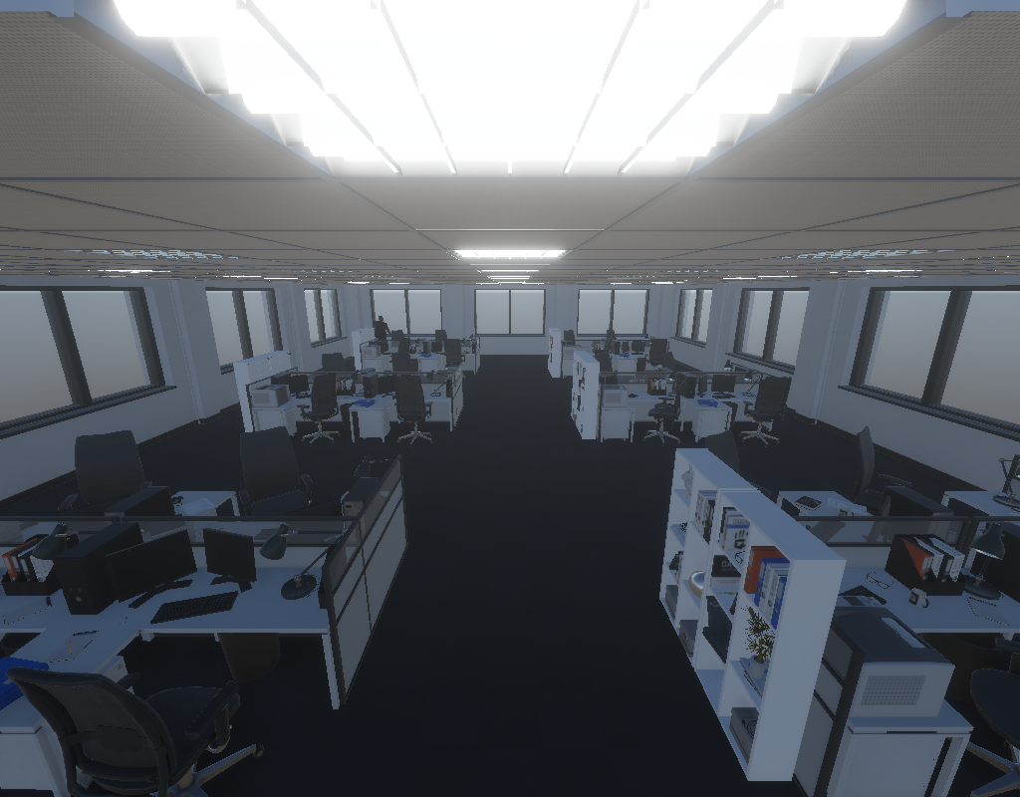
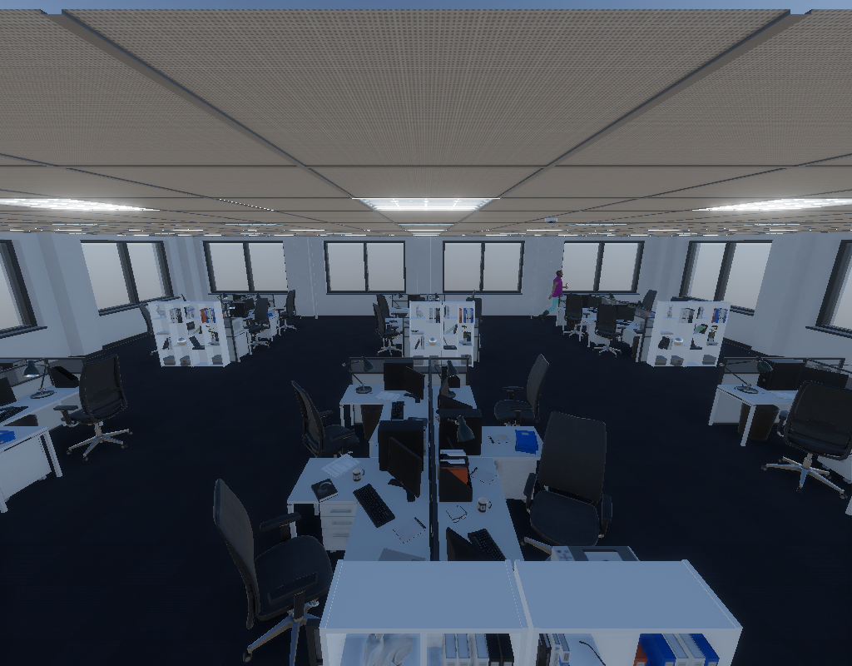
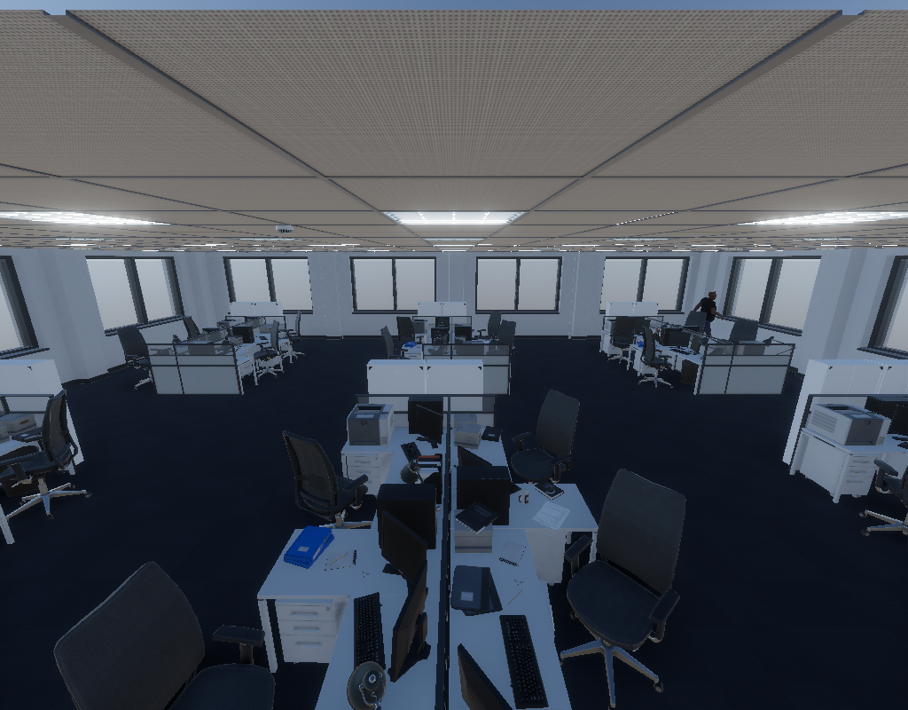

Slide 5


Slide 6
Classification & positioning head
Feature
…
Feature
Decoder
Feature
…
Feature
Decoder
Feature
…
Feature
Decoder
Feature
…
Feature
Decoder
Image
Processor
3D Detection Head
Image
Image
Image
Cell association vectors
…

Slide 7
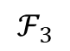
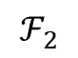
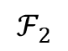
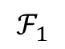
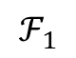
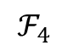
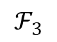
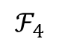
Multi-scale
visual features
Category Queries
Backbone
Neck
Convolutional layer
Neck
Feedforward
Transformer Block
Decoder
Convolutional layer
$$ℱ_{4}$$
$$ℱ_{4}$$
Decoder
Multi-head Cross Attention
Transformer Block
$$ℱ_{3}$$
$$ℱ_{3}$$
Convolutional layer
Decoder
Transformer Block
$$ℱ_{2}$$
$$ℱ_{2}$$
Normalization
Convolutional layer
$$ℱ_{1}$$
$$ℱ_{1}$$
Decoder
Transformer Block
Image
Processor
Multi-head self attention
Linear Embedding
3D Detection Head
Patch partition
Normalization
RGB
Image
RGB
Image
UE position &
Blockage indication
…
RGB Image
Queries

Slide 8

Classification & positioning head
Multi-scale visual features
UE voxel
Backbone
Neck
TCAN
Normalization
Decoder
Cross attention
Decoder
Decoder
Normalization
Decoder
Image
Processor
Linear Layer
Feed forward
RGB
Image
RGB
Image
Cell association vector
…
Image

Slide 9
Classification & positioning head
Multi-scale visual features
UE voxel
Backbone
Neck
Image
Processor
RGB
Image
RGB
Image
…
Image

Slide 11
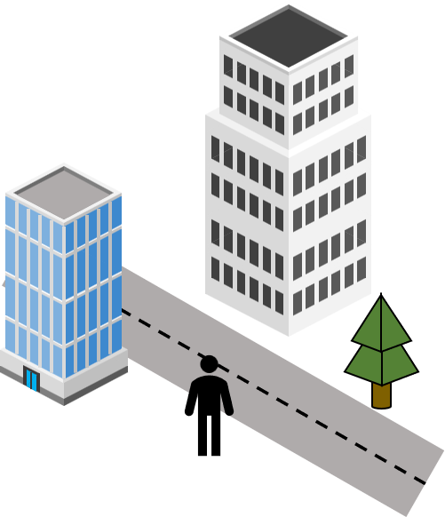
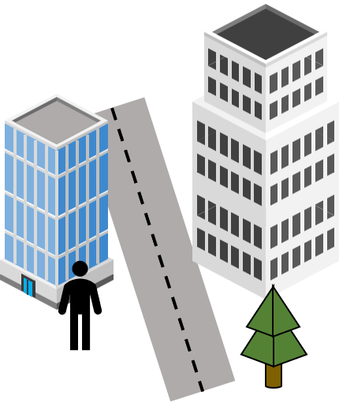
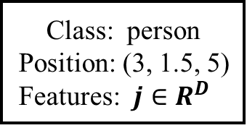
Multi-view images
Feature extraction
Voxelization
Backbone
Neck
Convolutional layer
Transformer block
(H/64, W/64, 768)
Convolutional layer
Transformer block
(H/32, W/32, 384)
Convolutional layer
voxel
Left view
Transformer block
(H/16, W/16, 192)
Convolutional layer
Transformer block
(H/4, W/4, 96)
Linear Embedding
3D object detection result
(H/4, W/4, 48)
Patch partition
Class: person
Position: (3, 1.5, 5)
Features: $j∈R^{D}$
(H, W, 3)
Right view
Detection head

Slide 12

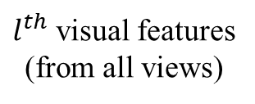

$l^{th}$ visual features
(from all views)
$1^{st}$ camera
$M^{th}$ camera
Value layer
Input
visual features
Key layer
Offset
Relevant
visual features
3d cartesian
position
Offset layer
Attention scores
Query layer
voxel features
Detected UE
: Matrix multiplication

Slide 13
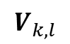
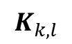
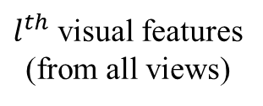
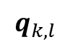
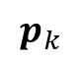
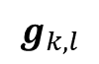
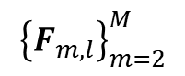
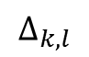
$${\left\{F_{m,l}\right\}}_{m=2}^{M}$$
$l^{th}$ visual features
(from all views)
$1^{st}$ camera
$M^{th}$ camera
$$V_{k,l}$$
Value layer
Input
visual features
$$K_{k,l}$$
$$Δ_{k,l}$$
Key layer
Relevant
visual features
Offset layer
Offset layer
Attention scores
Query layer
$$q_{k,l}$$
$$p_{k}$$
$$g_{k,l}$$
Estimated
position
Normalized
input
: Matrix multiplication

Slide 14
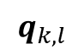
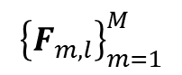
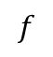
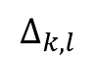
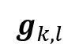
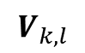
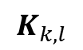
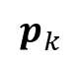
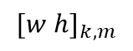
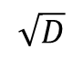
Vision attention network
$$g_{k,l}$$
$$p_{k}$$
$${\left\{F_{m,l}\right\}}_{m=1}^{M}$$
Projection
$${[w h]}_{k,m}$$
Offset layer
$$Δ_{k,l}$$
Query layer
Key layer
Value layer
$$q_{k,l}$$
$$K_{k,l}$$
$$V_{k,l}$$
$$f$$
softmax
$$\sqrt{D}$$
: Matrix multiplication

Slide 15
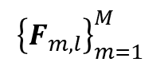
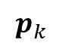
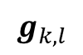
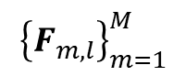
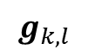
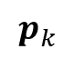
$$g_{k,l}$$
$${\left\{F_{m,l}\right\}}_{m=1}^{M}$$
$$p_{k}$$
Linear layer
Bilinear sampling
Projection
$$p_{k}$$
$${\left\{F_{m,l}\right\}}_{m=1}^{M}$$
$$g_{k,l}$$
Bilinear sampling
Linear layer
Linear layer
Linear layer
Softmax

Slide 16








Transformer-based cell association network (TCAN)
Attention block 1
Attention block L
…
Layer normalization
Layer normalization
Vision attention network
Vision attention network
$$R_{k}^{min}$$
$$j_{k}$$
Layer normalization
Layer normalization
Vector concatenation
Feed-forward network
Feed-forward network
$${\hat{c}}_{k}$$
Linear embedding
Sigmoid
layer
$$g_{k,1}$$
$$g_{k,L}$$
Fully connected layer
$$g_{k,0}$$
$${\hat{p}}_{k},{\left\{F_{m,1}\right\}}_{m=1}^{M}$$
$${\hat{p}}_{k},{\left\{F_{m,L}\right\}}_{m=2}^{M}$$

Slide 17




Transformer-based cell association network (TCAN)
Attention block 1
Attention block L
…
Layer normalization
Layer normalization
Vision attention network
Vision attention network
Layer normalization
Layer normalization
$$R_{k}^{min}$$
$$j_{k}$$
UE attention network
UE attention network
Vector concatenation
Fully connected layer
Layer normalization
Layer normalization
Linear embedding
Feed-forward network
Feed-forward network
Sigmoid
layer
$$g_{k,0}$$
$${\hat{p}}_{k},{\left\{F_{m,1}\right\}}_{m=1}^{M}$$
$$g_{k,1}$$
$$g_{k,L}$$
$${\hat{c}}_{k}$$
$${\hat{p}}_{k},{\left\{F_{m,L}\right\}}_{m=2}^{M}$$

Slide 18



$$R_{k}^{min}$$
$$j_{k}$$
Vector concatenation
Linear embedding
$$g_{k,0}$$

Slide 22
Queries
Cross Attention
Feedforward
Add & Norm
Normalization
Feed Forward
Multi-head Cross Attention
Cross attention
Add & Norm
Normalization
Normalization
Feed forward
Multi-head self attention
Normalization

Slide 25
Multi-scale visual features
Backbone
Neck
Backbone
Neck
Multi-scale
visual features
Image
Image

Slide 26




Backbone
Neck
Convolutional layer
$$F_{m}^{1}$$
Transformer Block
Convolutional layer
$$F_{m}^{2}$$
Transformer Block
Convolutional layer
$$F_{m}^{3}$$
Transformer Block
Convolutional layer
$$F_{m}^{4}$$
Transformer Block
Linear Embedding
Patch partition
RGB Image

Slide 27




Neck
Backbone
$$F_{m}^{1}$$
Convolutional layer
Transformer Block
$$F_{m}^{2}$$
Convolutional layer
Transformer Block
$$F_{m}^{3}$$
Convolutional layer
Transformer Block
$$F_{m}^{4}$$
Convolutional layer
Transformer Block
Linear Embedding
Patch partition
RGB Image

Slide 28












$$ℱ_{4}$$
…
$$ℱ_{4}$$
$$ℱ_{4}$$
$$ℱ_{3}$$
$$ℱ_{3}$$
…
$$ℱ_{3}$$
$$ℱ_{2}$$
$$ℱ_{1}$$
$$ℱ_{2}$$
…
$$ℱ_{2}$$
Feature
…
Feature
Feature
…
$$ℱ_{1}$$
$$ℱ_{1}$$

Slide 29
Feedforward
Multi-head Cross Attention
Normalization
Multi-head self attention
Normalization
Queries

Slide 30



Vision acquisition
Multiview processing
3D object and blockage detection
Cell association
: occluded object
Distance: 2m
Azimuth angle:
Elevation angle:
LOS:
: visible object
Top view
Person: 95%
(1.2 0.8 3)
Control
command
Small BS
Phone: 87%
Phone: 79%
Left view
y
(0.5 1.2 1.7)
z
x
Person: 92%
Right view

Slide 31
Proposed Computer Vision-based Cell Association using Transformer
Multi-view images
Computer vision stage
Cell association stage
Distance: 2m
Azimuth angle:
Elevation angle:
Single-view processing
Coordinate
post-processing
Voxelization
LOS link
post-processing
User positioning
Cell association
Cell association vector generation

Slide 32

Computer Vision-based Cell Association (CV-CA)
Multi-view-based 3D object detection
Distance: 2m
Azimuth angle: 30°
Elevation angle: 15°
Cell association
Transmission
Voxelization
Coordinate transformation
Voxel features $j$
3D object detection
Pilot signaling
CAN
Position of UE p
Cell association vector c
Beamforming angles
Features of UE j

Slide 33


1) Input data acquisition
(Image acquisition & feature extraction)
3) Cell association decision
2) Input data transmission
3D object detector
Visual features $F$
UE position p
Voxel features p
5) Control signaling
Transformer-based cell associator
(TCAN)
Cell association vector $c$
UDN environment

Slide 34



2) Cell association decision
Image acquisition
Voxelizer &
3D object detector
Visual features $\left(𝓕_{1}…𝓕_{M}\right)$
UE position p
1) Data rate request
Cell association network
(CAN)
Rate requirement $\left(R_{1}^{min}…R_{K}^{min}\right)$
Cell association c
3) Control signaling
Coordinate Transformation
Beamforming vector $\left(θ, φ\right)$
UDN environment

Slide 35
Small base station
User equipment
Vision range

Slide 36
Small base station
User equipment

Slide 37
Small BS

Slide 38
: occluded object
: visible object
Person: 95%
(1.2 0.8 3)
Phone: 87%
Phone: 79%
y
(0.5 1.2 1.7)
z
x
Person: 92%

Slide 39
LOS link
Azimuth angle: 25
Elevation angle: -19

Slide 41




y
Position of UE
$$φ$$
$$\left[x y z\right]$$
Position of SBS
x
$$\left[x y z\right]$$
$$θ$$
z
azimuth

